Slide 1
Characterizing, Modeling, and Benchmarking RocksDB Key-Value Workloads at Facebook
Zhichao Cao^{1,2}, Siying Dong² , Sagar Vemuri², and David H.C. Du¹
¹University of Minnesota, Twin Cities ²Facebook

Slide 2
Background

Slide 3








Key-Value Stores are Widely Used
……
SQL Database
Transactions
File system
Object storage
ML services
Storage services
……

Slide 4
Key-Value Store Research
The number of key-value store related papers appearing in some of the conference.
 | VLDB | SIGMOD | OSDI/SOSP | FAST | ATC
2017 | 3 | 3 | 3 | 1 | 5
2018 | 3 | 1 | 2 | 1 | 4
2019 | 1 | 1 | 2 | 6 | 4
2020 | ? | ? | ? | 5 | ?

Slide 5
Motivations
There are very limited studies of real-world workload characterization and analysis for KV- stores
The analytic methods for characterizing KV-store workloads are different from the existing workload characterization studies for block storage or file systems
How good the existing benchmarks are?

Slide 6
Contributions of Our Research
Introduce a set of trace collecting, replay, and analyzing tools for RocksDB.
Characterize the workloads of three typical RocksDB production use cases at Facebook and reveal several interesting findings.
Investigate the statistics of storage I/Os triggered by YCSB, compare it with the real-world workloads, and explore the limitations of YCSB.
Propose key-range based workload modeling and develop a new benchmark.

Slide 7
RocksDB Preliminary
compaction
compaction

Slide 8

Use Case 1: UDB
Applications
Primary key indexed raw mapping to a RocksDB KV-pair
SQL/Connections
RocksDB Key
RocksDB Value
Table Index Number
Primary Key
Columns
Checksum
MySQL
RocksDB
Secondary key indexed raw mapping to a RocksDB KV-pair
RocksDB Key
RocksDB Value
File System
Table Index Number
Secondary Key
Primary Key
Checksum
SSD

Slide 9
Use Case 2: ZippyDB
Read
Client
Secondary
Client
Read
RocksDB
Primary
Client
RocksDB
Write
Secondary
Client
RocksDB

Slide 10
Use Case 3: UP2X
ML/AI services data reads
User Profile Updates
UP2X
Merge
Get
Put
RocksDB
RocksDB
RocksDB
…….
RocksDB

Slide 11
Methodology and Tool Set

Slide 12



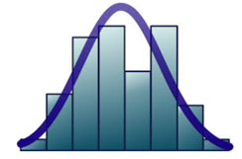
Production
Workloads
Trace files
Trace Collector
Trace Analyzer
Workload characteristics
Trace Replayer
Compare & Analyze
Benchmarking
RocksDB
Modeling

Slide 13
Workload Characterization Key Findings

Slide 14
Get is the most frequently used query type in UDB and ZippyDB, while Merge dominates the queries in UP2X
Query composition can be very different in different CFs in UDB

Slide 15
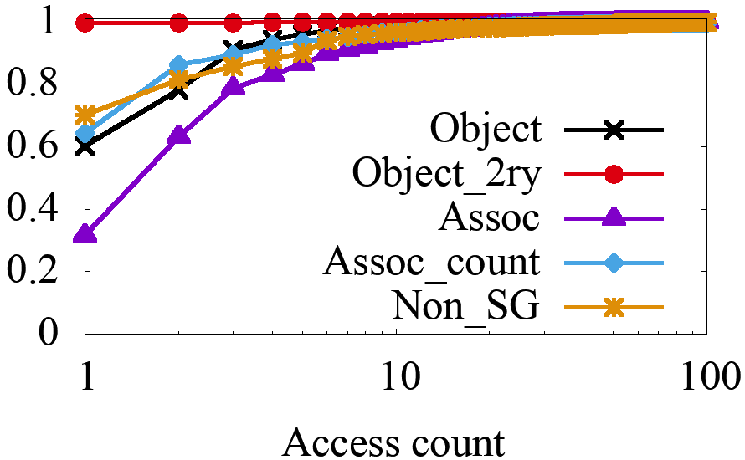
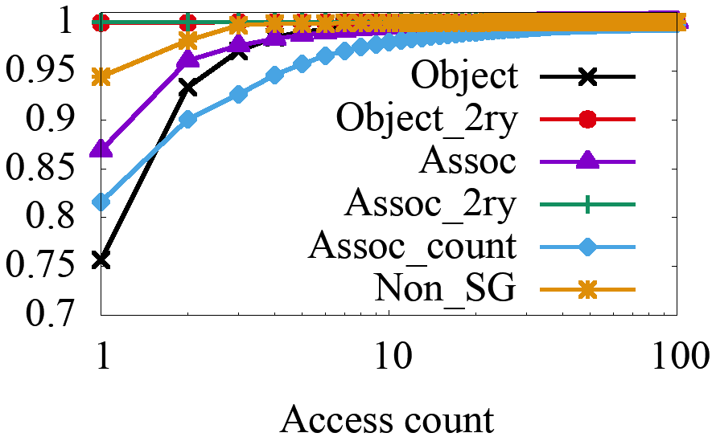
In UDB and ZippyDB, most KV-pairs are cold.
Only a very small portion of KV-pairs are hot.
Access count distribution of Get in UDB
Access count distribution of Put in UDB

Slide 16
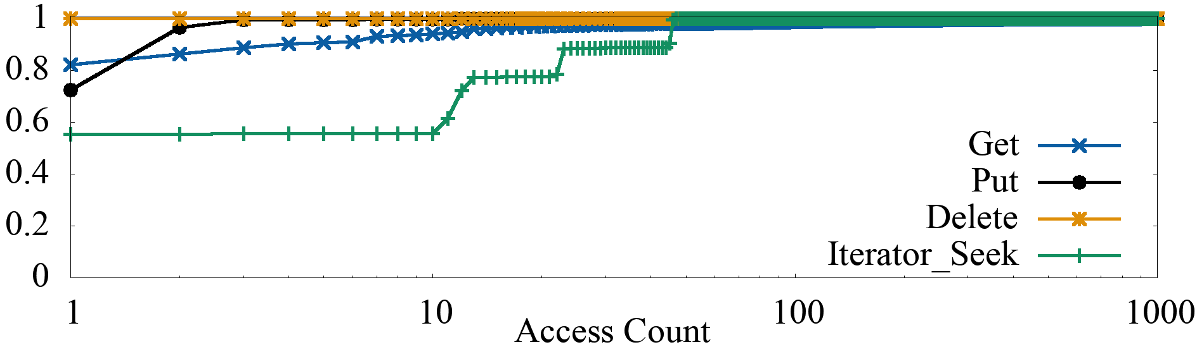
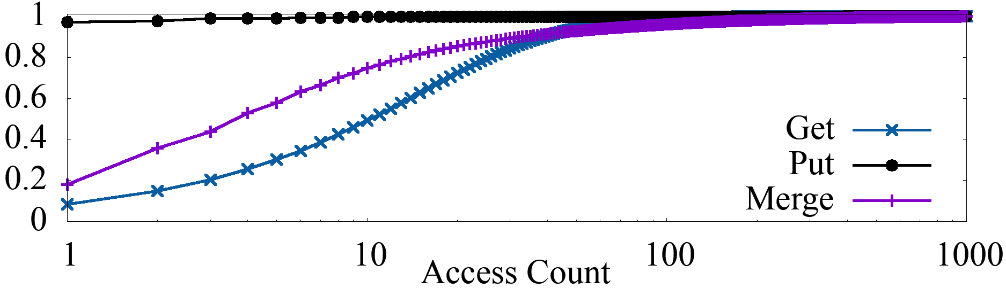
In UDB and ZippyDB, most KV-pairs are cold.
Only a very small portion of KV-pairs are hot.
Access count distribution ZippyDB
Access count distribution of UP2X

Slide 17
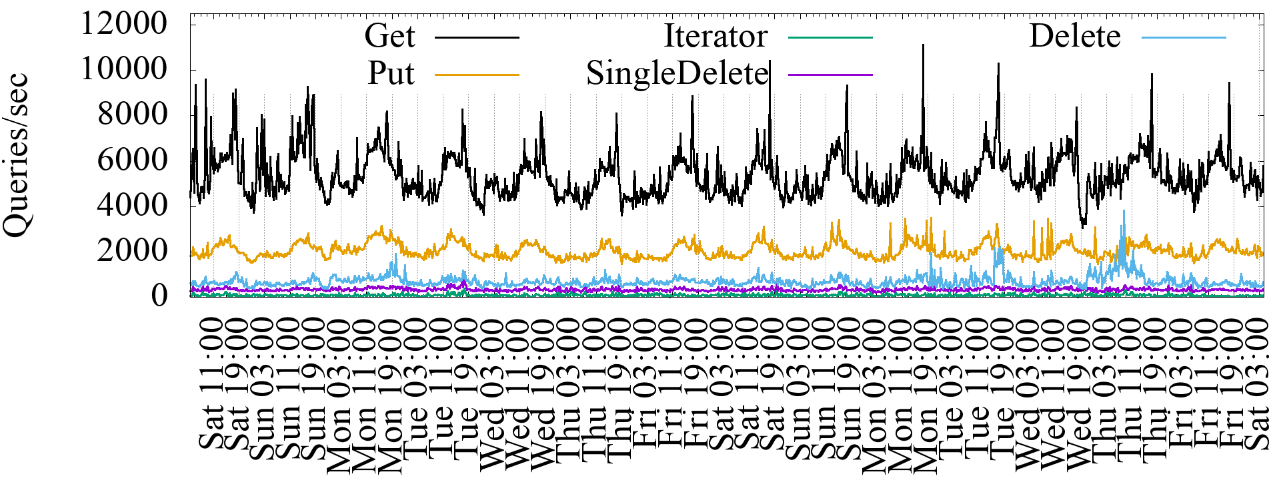
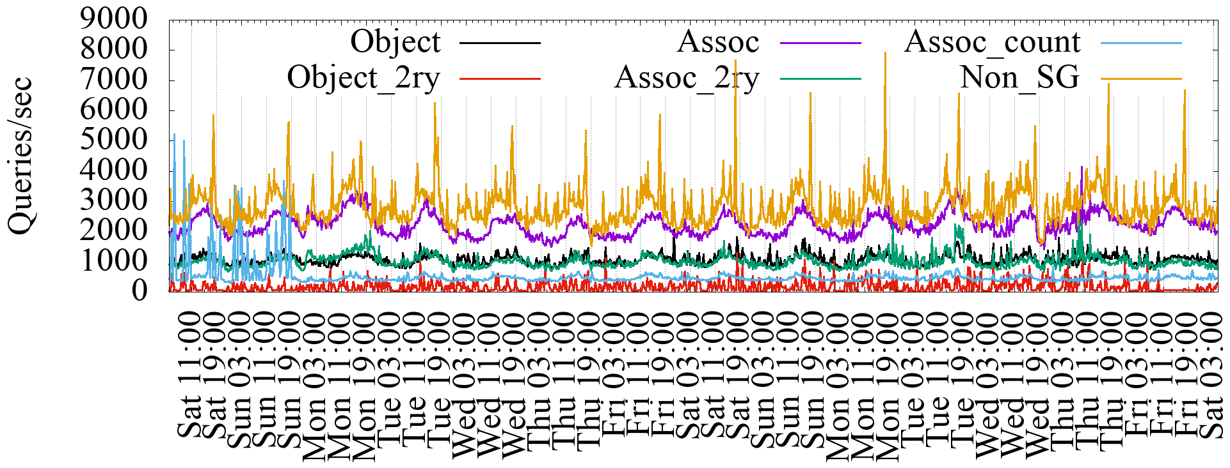
The QPS of some CFs in UDB have strong diurnal patterns, while we can observe only slight QPS variations during day and night time in ZippyDB and UP2X.
The daily QPS variations are related to social network behaviors.
QPS of different query types in UDB during 14-day period
QPS of different column families in UDB during 14-day period

Slide 18
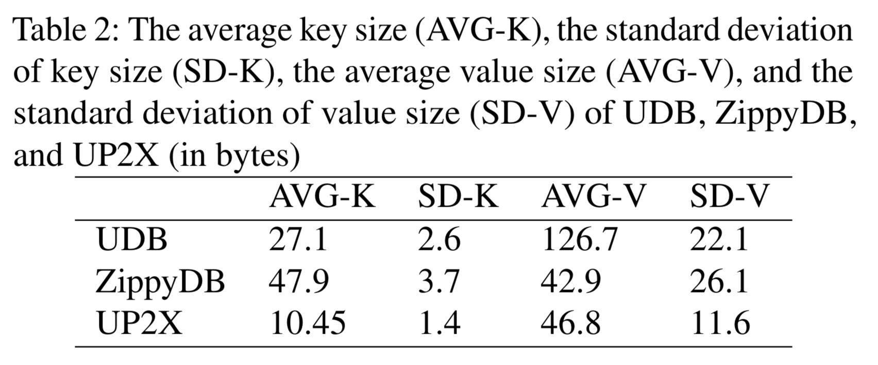
The standard deviation of key sizes is relatively small, while the standard deviation of value size is large.
The average value size of UDB is larger than the other two.

Slide 19
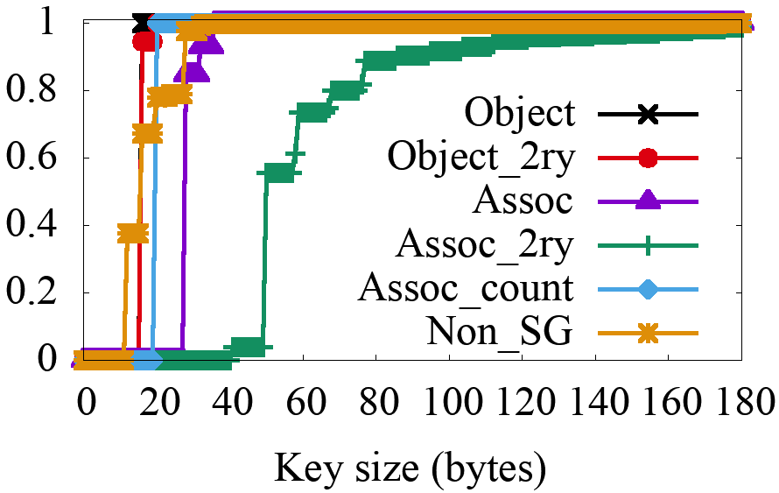
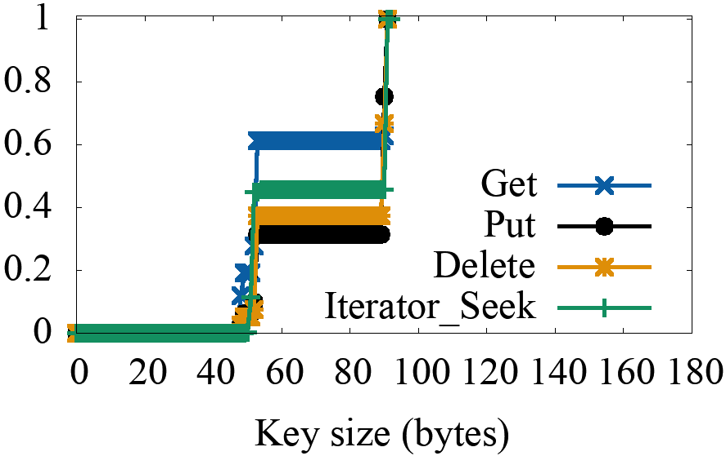
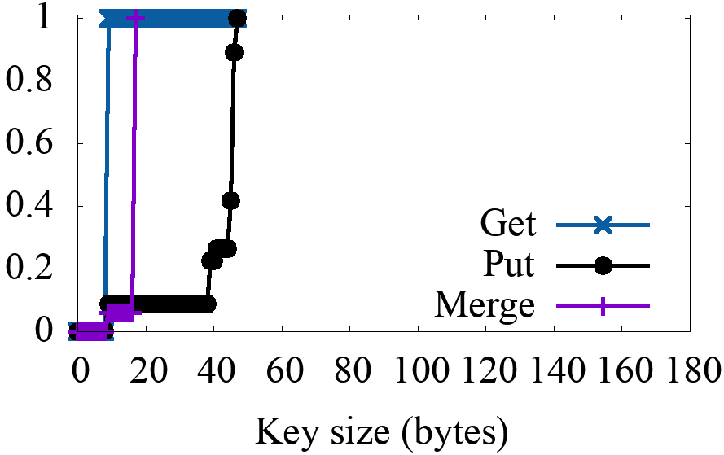
key sizes are usually small and have a narrow distribution, and value sizes are closely related to the types of data.
c
Key size distribution of UDB
Key size distribution of ZippyDB
Key size distribution of UP2X

Slide 20
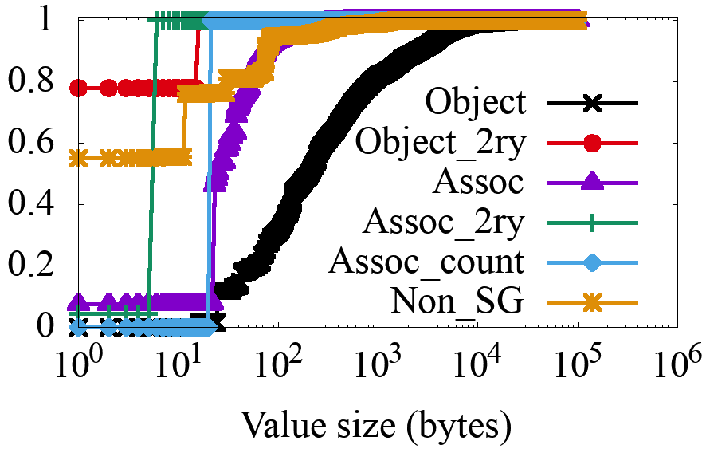
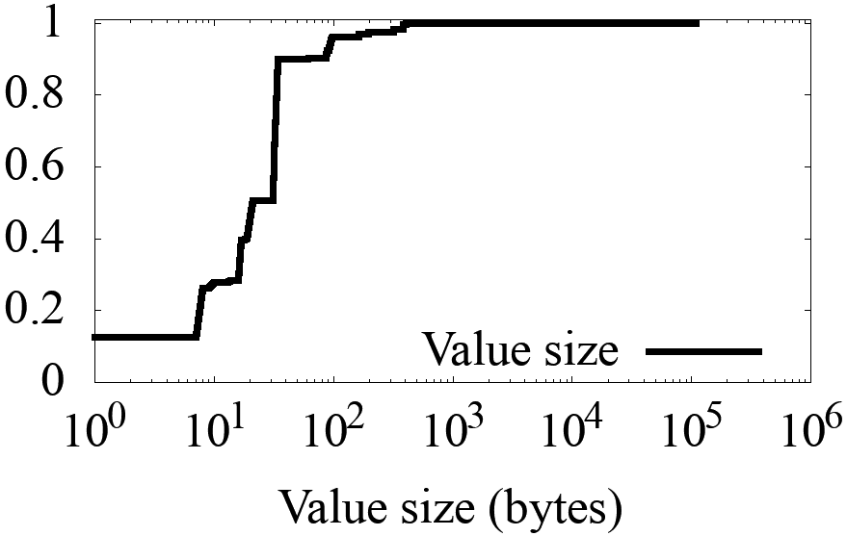
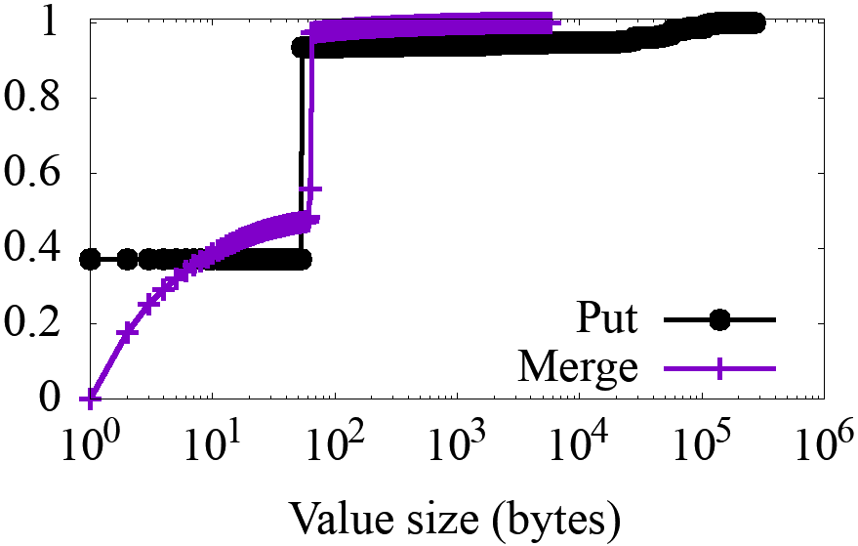
key sizes are usually small and have a narrow distribution, and value sizes are closely related to the types of data.
Value size distribution of UDB
Value size distribution of ZippyDB
Value size distribution of UP2X

Slide 21
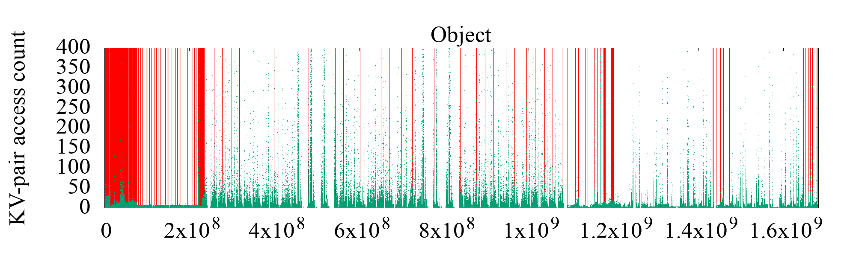
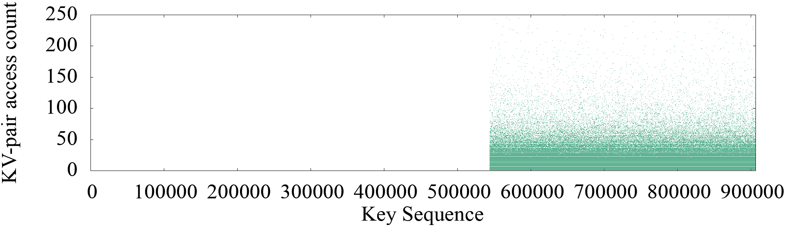
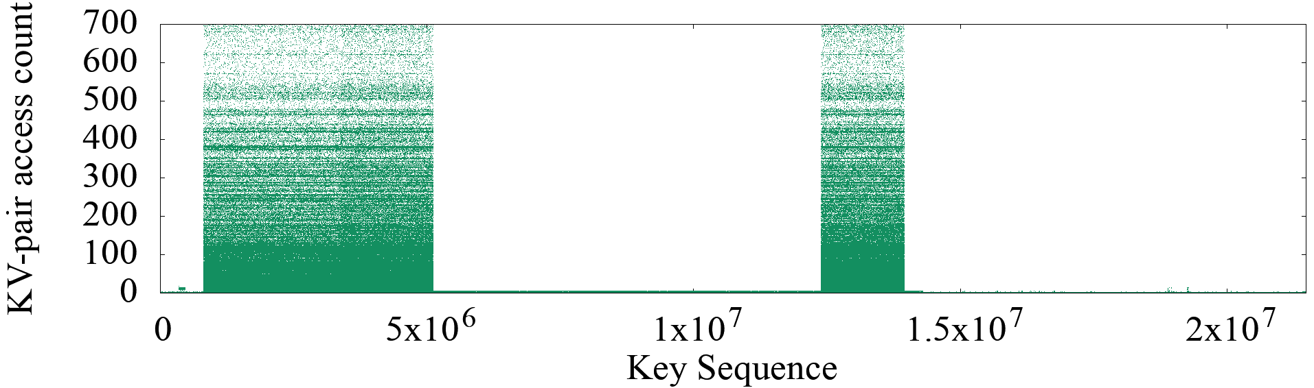
Column Family Object of UDB
The heat-maps of the three use cases show a strong key-space locality.
Hot KV-pairs are closely located in the key-space.
ZippyDB
UP2X
Note:
1) Keys are first sorted the same as they are in the database, and assigned with a integer as key sequence number.
2) Y-axis is the access count of a KV-pair during 24-hour
period.
3) Red line is the separation of MySQL tables.

Slide 22
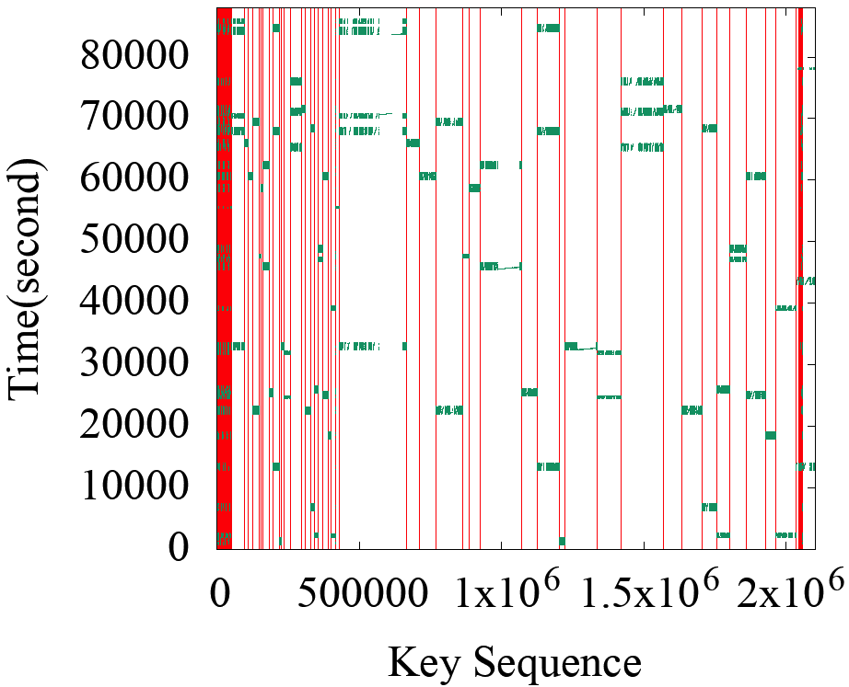
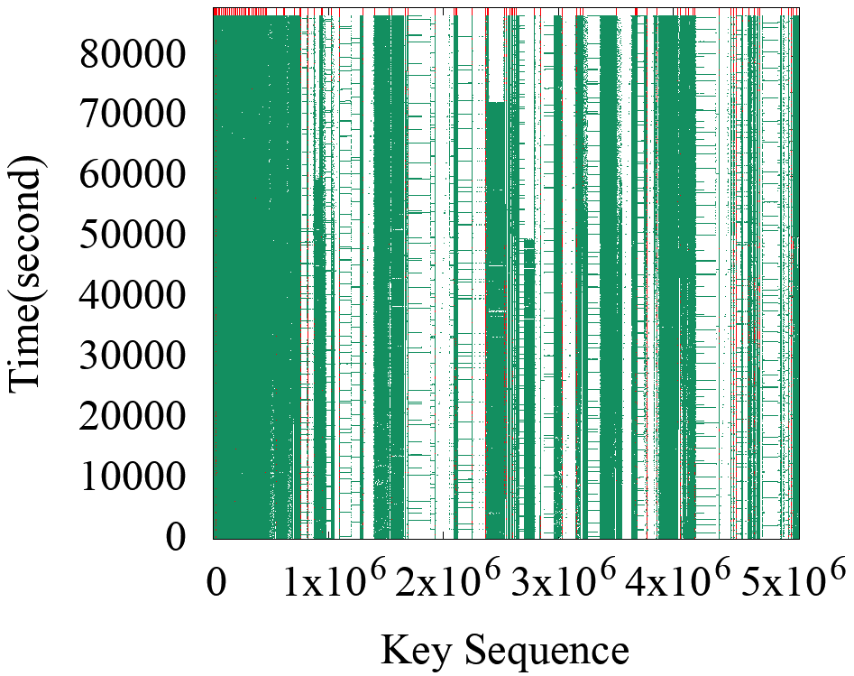
The time series figures of Delete and SingleDelete for UDB and Merge for UP2X show strong temporal locality.
For some query types, KV-pairs in some key-ranges are intensively accessed during a short period of time.
Time series figure of KV-pairs being SingleDeleted in Assoc_2ry of UDB
Time series figure of KV-pairs being Deleted in Object of UDB
Note: 1) X-axis is the key sequence number which is the same as that in heatmap, 2) Y-axis is time starting and
starts at the time when tracing begins, and 3) Red line is the separation of MySQL tables.

Slide 23
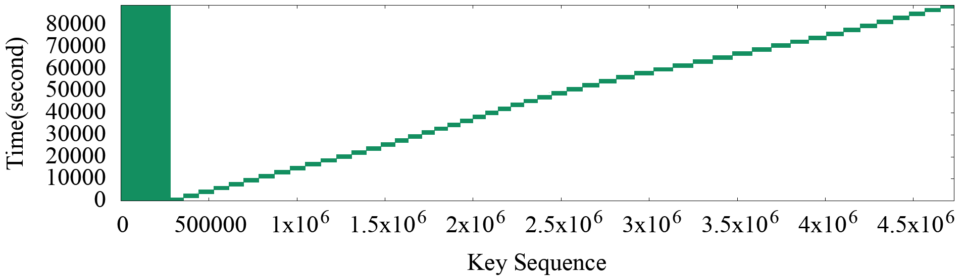
The time series figures of Delete and SingleDelete for UDB and Merge for UP2X show strong temporal locality.
For some query types, KV-pairs in some key-ranges are intensively accessed during a short period of time.
Time series figure of KV-pairs accessed by Merge in UP2X
Note: 1) X-axis is the key sequence number which is the same as that in heatmap, 2) Y-axis is time starting and
starts at the time when tracing begins, and 3) Red line is the separation of MySQL tables.

Slide 24
Modeling and Benchmarking

Slide 25



Production
Workloads
Trace files
Trace Collector
Trace Analyzer
Workload characteristics
Trace Replayer
Compare & Analyze
Benchmarking
RocksDB
Modeling

Slide 26
Production
Workloads
Trace files
Trace Collector
Trace Analyzer
Workload characteristics
Trace Replayer
Compare & Analyze
Benchmarking
RocksDB
Modeling

Slide 27
Investigate the Backend Storage I/Os
YCSB can generate queries that have similar statistics for a given query type ratio, KV-pair hotness distribution, and value size distribution as those in realistic workloads.
However, it is unclear whether their generated workloads can match the I/Os for underlying storage systems in realistic workloads.
We focus on: block reads (block_read), block cache hits (block_cache_hit), bytes being read (read_bytes), and bytes being written (write_bytes).
YCSB
KV queries
RocksDB
Data block reads/writes
File System
SSD

Slide 28
Replay of ZippyDB vs. Fitted YCSB
Read more
write less
Replay

Slide 29
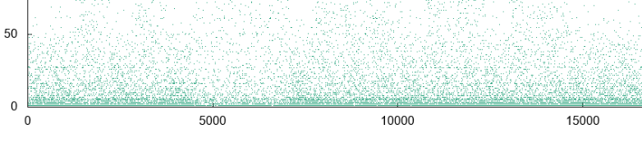
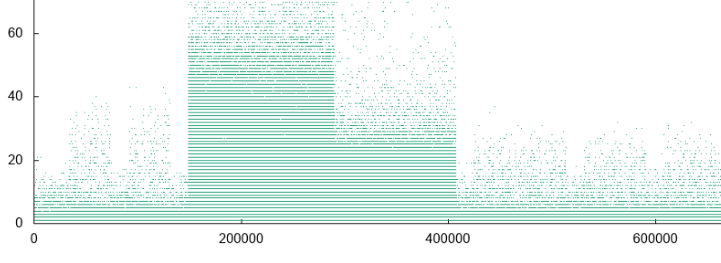
Problem and Solution
The hot KV-pairs are actually randomly distributed in the whole key-space
Due to the cache space limit, a large number of hot data blocks that consist of the requested KV-pairs will not be cached, which triggers an extremely large number of block reads.
Instead of only modeling the overall KV-pair hotness, we cut the whole key space into small key-ranges and models the hotness of key-ranges.
In each key-range, KV-pairs also follows the overall hotness distributions.
Build the new benchmark based on key-range based modeling
Heatmap changes

Slide 30
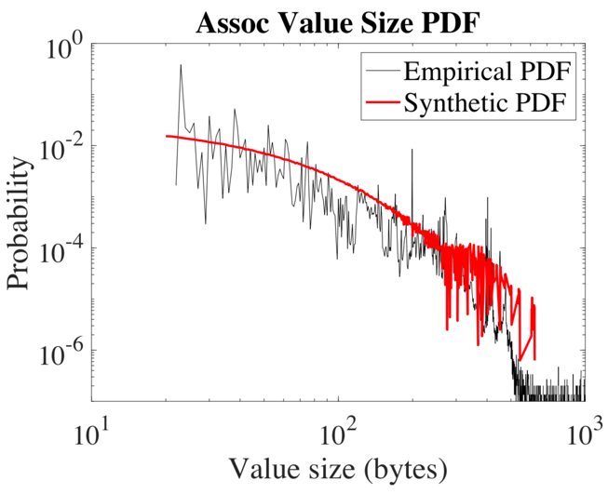
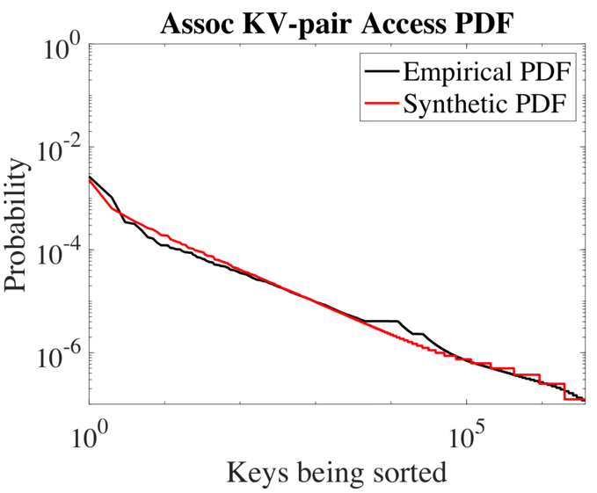
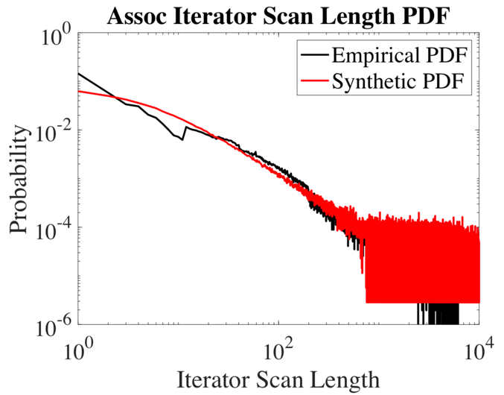
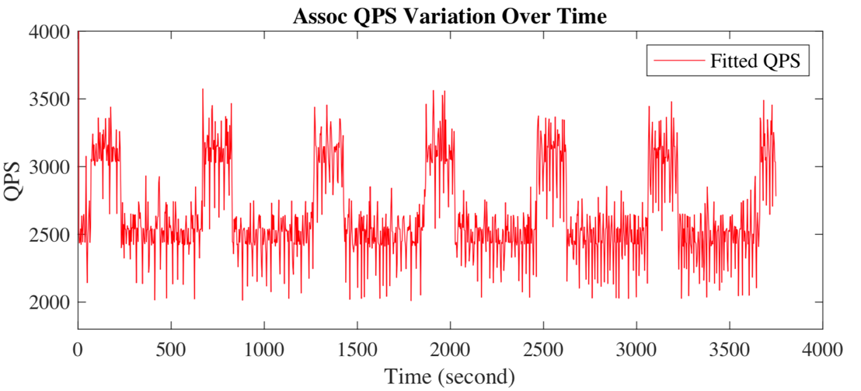
New Benchmark Statistic Verification

Slide 31
New Benchmark vs. YCSB
All_random: KV-pairs are randomly distributed
All_dist: hot KV-pairs are allocated together
Prefix_random: KV-pairs are allocated to different key-ranges based on key-range hotness. KV-pairs in a Key-range are randomly distributed.
Prefix_dist: KV-pairs are allocated to different key-ranges and hot KV-pairs in a key-range are allocated close by

Slide 32
Conclusion and Future Work

Slide 33
With the help of tracing, replaying, and analyzing tools, we characterized key-value workloads of three typical RocksDB production use cases at Facebook. The findings of key/value size distribution, access patterns, key-range localities, and workload variations provide insights that can help optimize KV-store performance.
We propose a key-range based model to better preserve key-space localities. The new benchmark not only provides a good emulation of workloads at the query level, but also achieves more precise RocksDB storage I/Os than that of YCSB.
In the future, we will continue improve YCSB such as key-range based distribution and QPS variation. Also, we will extend the workload characterization to other dimensions such as the correlations between queries, the correlation between KV-pair hotness and KV-pair sizes.

Slide 34
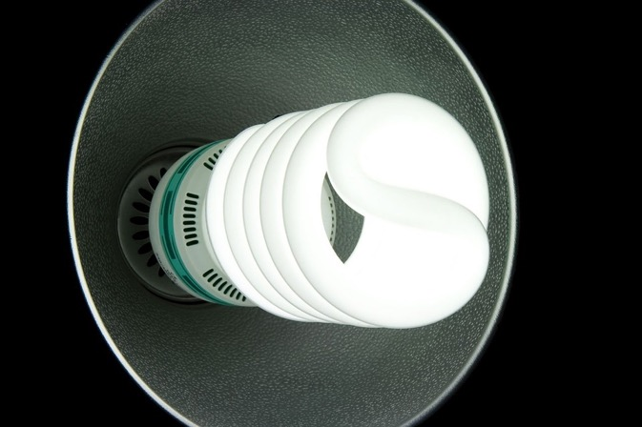
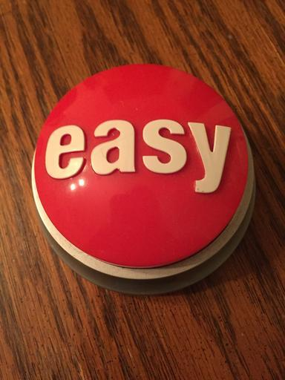

Future of RocksDB
A fast and easy to use persistent key-value store for any workload on any hardware platform.
Efficiency
Easy To Use
Performance

Slide 35
Thank You!
Q&A

